Slide 1

The Impact of Mindfulness Meditation on Decision-Making under Stress and Sleep Quality in Firefighters
Group 12 : Benjamin Tan, You Wu, Siyang Yu, Yuxuan Zhao

Slide 2

AGENDA
Background Information
Research Questions
Research Plan
Statistical Analysis Plan
Limitation & Uncertainty
Simulation

Slide 3
What is the research about?
Firefighters
Mindfulness meditation
Decision-making
Sleeping quality
Why is it matters?
Operational efficiency
Community safety
Research

Slide 4


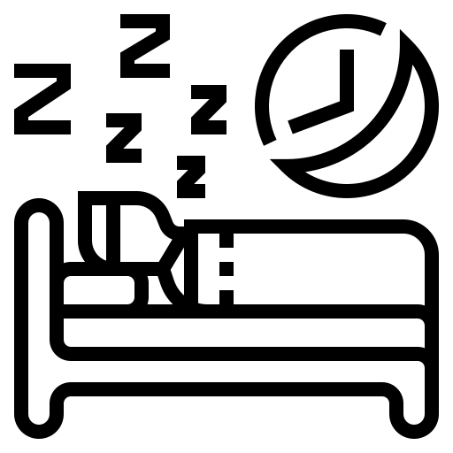
Research Questions
Relative to firefighters who do not practice mindfulness meditation, would the mindfulness meditation program lead to better:
5%
5%
5%
Decision-making accuracy under stress
Decision-making reaction time under stress
Sleep Quality
H_{0A}:μ_{T} - μ_{C} ≤ 0
H_{1A}: μ_{T} - μ_{C} > 0
H_{0B}: г_{T} - г_{C} ≤ 0
H_{1B}: г_{T} - г_{C} > 0
H0c: 𝘲_{T} - 𝘲_{C} ≤ 0
H1c: 𝘲_{T} - 𝘲_{C} > 0

Slide 5

Research Plan
Population of Interest
Active-duty firefighters stations across different states within the United States.
Sample Selection
Fire departments from 10 states with the highest number of wildfires per year.
Urban and Rural areas: California, Texas, Colorado, Arizona, Idaho, Washington, Oklahoma, Oregon, Montana, and Utah.
Cumulative number of 27,166 fire stations.
Select 5 fire stations per state.
50 fire stations in total.

Slide 6
Research Plan
Brief Schedule - 4 months study
Phase 1: Planning and preparation (3 weeks, from September 1st, 2024)
Week 1: Conduct research, finalize selection of firefighting stations participating. Randomly divide station into control and treatment groups.
Week 3: Initialise training sessions for researchers, and meditation trainers for cyber security, responsibility, training schedule, and resource allocation to all fire stations.
Phase 2: Sample selection and education training (2 months, mid-September - mid-November, 2024)
Week 4 - Week 10: Provide training to treatment group in the classroom. Monitor the regular practice of mindfulness and provide continuous support

Slide 7
Research Plan
Brief Schedule - 4 months study
Phase 3: Field training, project monitoring, and data collecting (1 month, mid-November - mid-December, 2024)
Week 11: Conduct live fire training drills, both treatment and control groups will participate and enter burning structure carrying fire hose.
Week 14: Collect data on decision-making accuracy, reaction time, sleep quality, and stress levels.
Phase 4: Analysis and Reporting (1 week, till December 30th, 2024)
Week 15: Analyze data using statistical methods. Prepare and submit reports to stakeholders.

Slide 8
Research Plan
Brief Schedule - 4 months study
Email invitation to firefighter departments
Classroom training with added mindfulness meditation (40-45 minutes)
(different no-mindful-effect training for control group)
Conduct live fire training drills, both treatment and control groups will participate and enter burning structure carrying fire hose.
Collect data on decision-making accuracy, reaction time, sleep quality, and stress levels.
Analyze data using statistical methods. Prepare and submit reports to stakeholders.
Operational Procedure
Main Reason: According to USFA, the seasonal nature of fire is a crucial factor, and the highest incidents occur from late winter till summer for outside, vehicle and structure fire.
Step1: Contact emergency management and Human Resources department for cooperation.
Step2: train our participants. 40-45 minutes (Mindful Leader, n.d.) mindfulness meditation to the treatment cohort.
Step 3:After 2 months training, conduct on-site exercise to test our research questions.
Step4: Place the experimental operation in winter. ( According "The Seasonal Nature of Fires", winter and festivals are fire-prone periods. )

Slide 9

Research Plan
Data Collection
Decision-making accuracy
(measured by real estimate tests, score range 0-10)
Decision-making time
(measured by stopwatch in seconds)
Sleep quality
(measured by smart wearable)
Variables
Outcome
(Two months of mindfulness meditation training)
Treatment
(Data collected listed above)

Slide 10
Statistical Analysis Plan
Step 1: Descriptive statistics
For demographic attributes of the study participants, such as age, gender, fire station, rank etc
Mean and SD of decision accuracy, decision reaction speed scores for the treatment and control groups
Step 2: Inferential statistics used to test research hypotheses
All the Research Questions will be performed with a Two sample One-sided t-test
HA1: Greater average decision accuracy observed in the treatment group compared to the control group.
HA2: Greater average decision reaction speed observed in the treatment group compared to the control group.
HA3: Greater average sleep quality observed in the treatment group compared to the control group.
Step 3: Effect Size Calculation
Cohen's D will be calculated to estimate the size of the experiment’s effect on decision accuracy, decision reaction speed and sleep quality for the treatment group versus the control group.

Slide 11
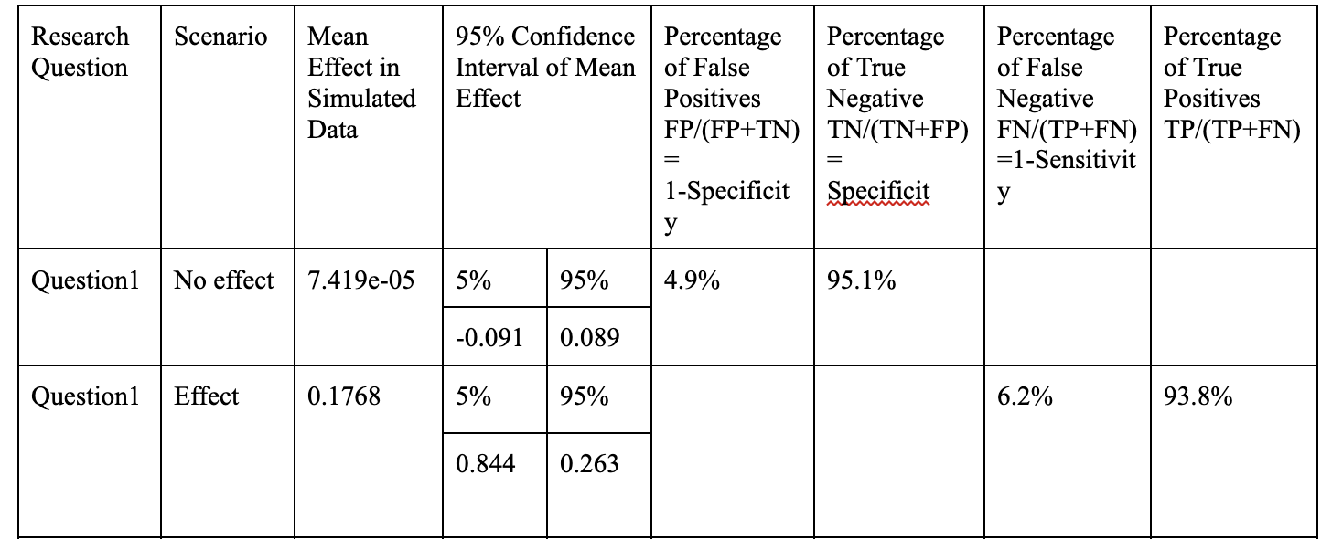
RQ1: Relative to firefighters who do not practice mindfulness meditation, would the mindfulness meditation program lead to better decision-making accuracy under stress among firefighters?
This simulation result support our prediction with 93.8% in True Positive Percentage of 93.8%

Slide 12
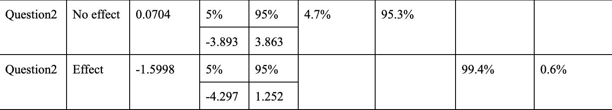
RQ2: Relative to firefighters who do not practice mindfulness meditation, would one mindfulness meditation program lead to a better decision-making reaction time under stress among firefighters?
The result of this simulation indicating that there’s no effect on meditation for Firefighter’s reaction time

Slide 13
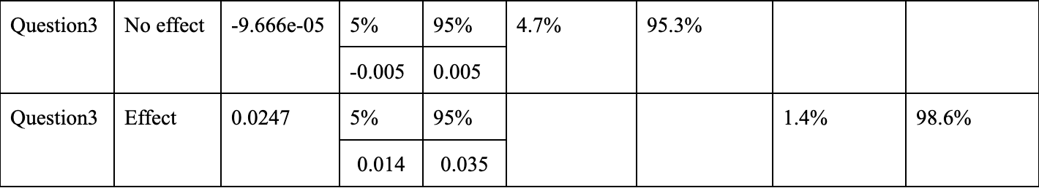
RQ3: Relative to firefighters who do not practice mindfulness meditation, would one mindfulness meditation program lead to better sleep quality among firefighters?
This simulation result support our prediction with 98.6% in True Positive Percentage of 93.8%

Slide 14
Possible Recommendations
Scenario 1: Null Hypothesis Not Rejected
If the study does not find significant evidence to reject the null hypothesis, it suggests that mindfulness meditation may not have a measurable impact on decision-making accuracy or sleep quality in emergency responders compared to the control group.
In this case, we recommend broadening the scope of research to explore other potential interventions and strategies that could effectively enhance decision-making capabilities and sleep quality in emergency responders. This could include different types of stress management techniques, physical wellness programs, or cognitive-behavioral approaches.
It's important to note that the lack of observed effect in this study does not categorically rule out the benefits of mindfulness; it may still have subjective or unmeasured benefits. Further research could explore these aspects or different methodologies for mindfulness training.
Scenario 2: Null Hypothesis Rejected
If the null hypothesis is rejected, indicating a significant positive impact of mindfulness meditation on decision-making and sleep quality among emergency responders, we advocate for the integration of mindfulness practices into their routine training and wellness programs.
It will be important to develop a structured mindfulness meditation program tailored to the unique needs and schedules of emergency responders. This program should be designed to be easily accessible and feasible to implement within their existing work structure.
Additionally, we recommend ongoing research to continuously evaluate and refine the mindfulness program, ensuring its effectiveness and alignment with the evolving needs of emergency responders.

Slide 15
Limitations and Uncertainties
Participation Consistency
Long-Term Sustainability
Short-Term Effects
Individual variability
Ethical concerns
Notes:
Consistency in Participation:
There is a chance that some participants might choose to discontinue their involvement in the mindfulness meditation and opt out of this experiment.
Individual variability:
There are possibilities of individual variability in how responders experience and benefit from mindfulness meditation, which might contribute to inconsistent results.
Long-Term Sustainability: The study may not account for the long-term sustainability and effectiveness of mindfulness programs within the emergency response context, and the findings might not reflect how these practices evolve over time.
Ethical concerns:
ethical concerns may occur during the meditation process, especially when considering the wellbeing of emergency responders and the potential risks associated with meditation, which may not be addressed in this research.
Short-Term Effects:
The study might focus on short-term effects of mindfulness meditation, while the long-term impact may differ. Emergency responders' experiences with meditation may evolve over time.

Slide 16
Conclusion
Measurable: Recording (1) decision accuracy and (2) Decision Reaction Time and (3) Sleep Quality
Actionable: Fire Administration can take action to integrate the mindfulness mediation program into part of their Training
Meaningful: Meaningful effect of 5% for Decision Accuracy and 5% for sleep quality contributes substantially to overall test score
Achievable: Ability to carry out experiment that can answer Research questions

